Slide 1


Institute of Emerging Careers
PIZZA SALE PROJECT
PRESENTATION
77
Presented by
Guided by
MUHAMMAD YOUSAF
SIR MISBHA
MAM MARYAM

Slide 2
PIZZA SALE

Slide 3
Key Points: Order: Represents an order placed by a customer. Order Details: Contains details of each item in an order, linking to specific pizzas. Pizza: Represents individual pizzas with specific sizes and prices. Pizza Type: Defines the type, category, and ingredients of pizzas.

Slide 4
DATA Dictionary:
Field Name | Data Type | Description | Example
order_id | String | A unique identifier for the order | "ORD123456"
order_date | Date | The date when the order was placed | "2024-05-27"
order_time | Time | The time when the order was placed | "14:30:00"
order_details_id | String | A unique identifier for the order details entry | “1”
order_id | String | A unique identifier for the order | "ORD123456"
pizza_id | String | A unique identifier for the pizza | "PIZZA001"
quantity | Integer | The number of pizzas ordered | 2
pizza_type_id | String | A unique identifier for the type of pizza | "PT001"
name | String | The name of the pizza | The maxi can piza"
category | String | The category to which the pizza belongs | “veggie"
ingredients | String | A comma-separated list of ingredients in the pizza | "Tomato, Mozzarella, Basil"
pizza_id | String | A unique identifier for the pizza | "PIZZA001"
pizza_type_id | String | A unique identifier for the type of pizza | "PT001"
size | String | The size of the pizza | “l"
price | Decimal | The price of the pizza | 15.99

Slide 5
). Objectives for Pizza Order Data Analysis: Total Orders Placed Determine the total number of orders placed. Total Revenue Generated Calculate the total revenue generated from all orders. Highest Priced Pizzas Identify the top five pizzas with the highest prices. Most Common Pizza Sizes Identify the most frequently ordered pizza sizes. Top 10 Pizza Types Ordered List the top ten pizza types with the highest order quantities. Quantity by Category Calculate the total quantity of each pizza by category. Order Distribution by Hour Analyze the distribution of orders by the hour of the day. Category-wise Distribution Analyze the distribution of ordered pizzas by category. Average Orders Per Day Group orders by date and calculate the average number of pizzas ordered per day. Top 3 Revenue-Generating Pizzas Identify the top three pizzas that generate the most revenue. Percentage Revenue by Pizza Type Calculate the percentage of total revenue contributed by each pizza type. Cumulative Revenue Over Time Track the cumulative revenue over the order dates.

Slide 6
Questions: 1 Retrieve the total no order placed: 2 Calculate the total revenue generate: 3 Identify the first five pizzas highest prices: 4 Identify the most common pizza size orders. 5 10 most orders pizzas type: along their quantities: 6 Total quantity of each pizza by category orders: 7 Distribution the order by hour OF the DAY 8 Category wise distribution of ordered pizzas: 9 Group the orders by date and calculate the average no of pizzas order per day: 10 Determine the top 3 order pizzas on revenue 11 Calculate the total percentage revenue of pizza type to total revenue: 12 Cumulative revenue over order date:

Slide 7
DATA SET Link:
https://kaggle.com/datasets/mysarahmadbhat/pizza-place-sales

Slide 8

Dataset Summary
Summary: Power BI Dashboard for Pizza Orders
Created a Power BI dashboard for pizza orders analysis. Cleaned and transformed raw data, established relationships between tables, and designed interactive visualizations. Insights include peak ordering hours, popular pizza choices, and delivery efficiency. Facilitates data-driven decision-making and operational optimization in the pizza delivery service.
.

Slide 9
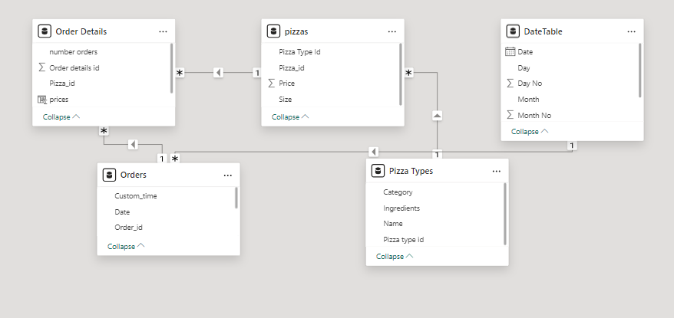
ERD:

Slide 10
ERD: ORDERS:
OODFJ
Attributes:
order_id (Primary Key): Unique identifier for the order.
order_date: Date when the order was placed.
order_time: Time when the order was placed.

Slide 11
Order Details
Attributes:
order_details_id (Primary Key): Unique identifier for the order details entry.
order_id (Foreign Key): Reference to the order.
pizza_id (Foreign Key): Reference to the pizza.
quantity: Number of pizzas ordered.

Slide 12
Pizza Attributes: pizza_id (Primary Key): Unique identifier for the pizza. pizza_type_id (Foreign Key): Reference to the type of pizza. size: Size of the pizza (e.g., Small, Medium, Large). price: Price of the pizza.

Slide 13
Pizza Type Attributes: pizza_type_id (Primary Key): Unique identifier for the type of pizza. name: Name of the pizza type (e.g., Margherita, Pepperoni). category: Category of the pizza (e.g., Vegetarian, Non-Vegetarian, Vegan). ingredients: Comma-separated list of ingredients.

Slide 14


Exploratory Data Analysis
It is an approach of analyzing data to summarize their main characteristics, often using statistical graphics and other data visualization methods.
14

Slide 15
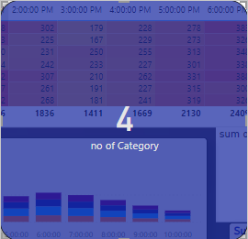
Total category of pizzas:

Slide 16
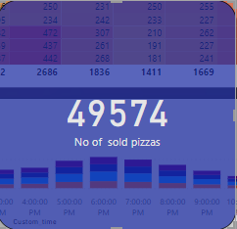
Total number of orders pizzas:

Slide 17
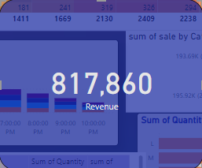
REVENUE:

Slide 18
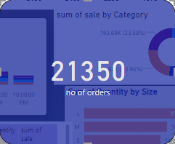
Total number OF ODERS:
18

Slide 19
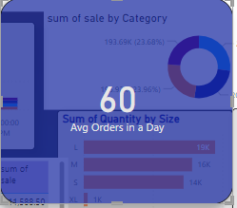
AVG ORDERS IN A DAY:

Slide 20
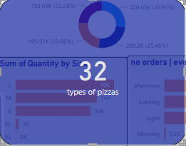
Total Types of Pizzas in Subcategory:

Slide 21
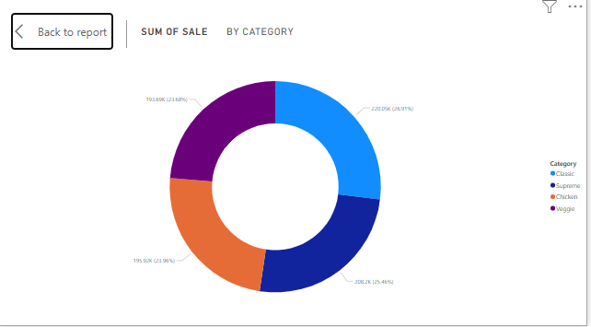
Sum of sale by category of pizzas:

Slide 22
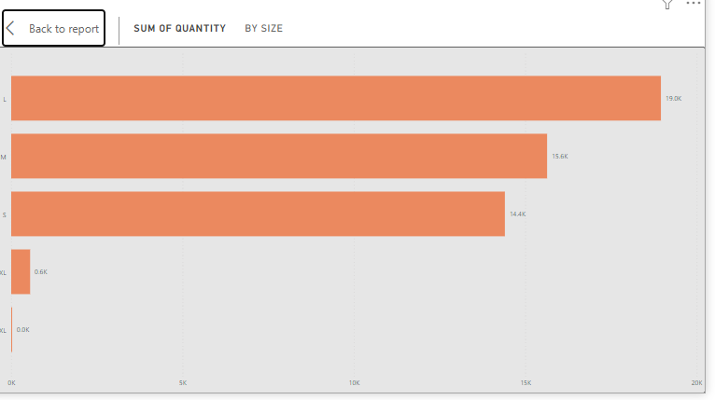
Sum of quantity by size of pizzas:

Slide 23
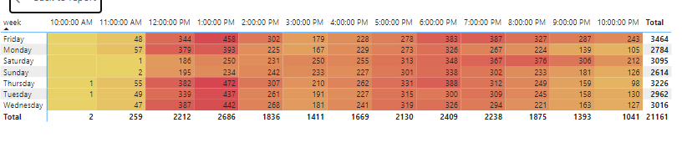
Total Number of Orders Every Week:

Slide 24
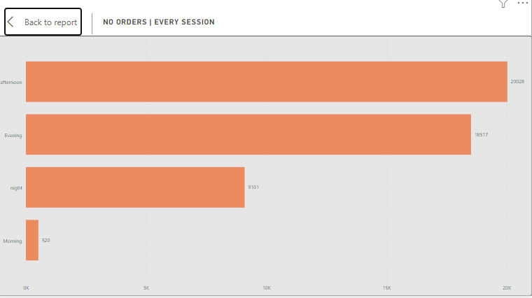
No orders | every session:

Slide 25
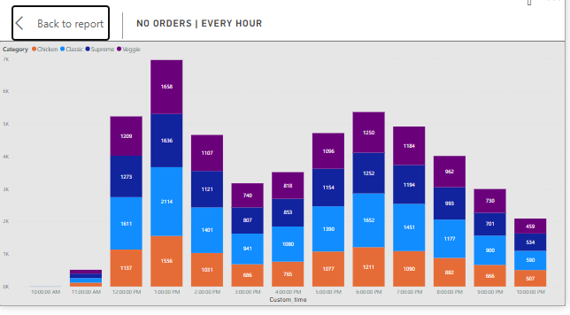
No Orders Per Hour :

Slide 26
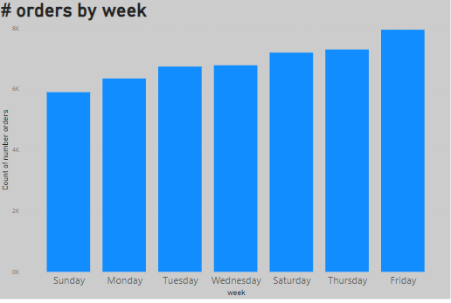
Number of ORDERS BY WEEK:

Slide 27
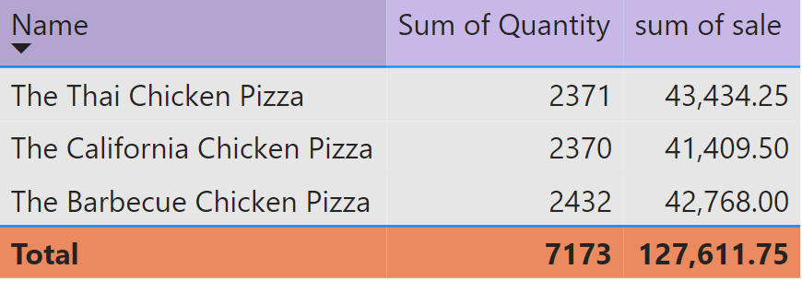
Report of the top 3 sold pizzas with quantity:

Slide 28
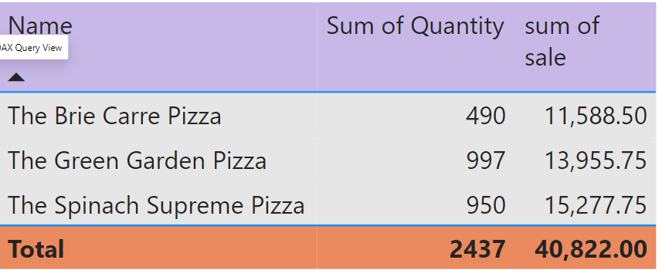
Report of the Last 3 Sold Pizzas with Quantity

Slide 29
Recommendations for Pizza Order Data Analysis:

Slide 30
Recommendation: Focus on Popular Sizes Most Common Pizza Sizes: Align marketing and promotional efforts with the most frequently ordered pizza sizes to maximize sales. Enhance Revenue from Top Sellers Top 3 Revenue-Generating Pizzas: Promote the top three revenue-generating pizzas through targeted marketing campaigns to boost overall revenue. Efficient Resource Allocation Order Distribution by Hour: Adjust staffing and operational resources according to peak order times to enhance service efficiency and customer satisfaction. Category-Specific Promotions Category-wise Distribution: Develop category-specific promotions based on the distribution of ordered pizzas by category to drive sales in less popular categories. Monitor Sales Trends Cumulative Revenue Over Time: Regularly track cumulative revenue to identify trends and make timely strategic decisions to maintain or improve sales performance. Data-Driven Marketing Average Orders Per Day: Use insights from average daily orders to plan effective marketing campaigns and promotional offers to drive consistent sales throughout the week. Revenue Contribution Analysis Percentage Revenue by Pizza Type: Focus on enhancing the menu and marketing efforts for pizza types contributing significantly to total revenue to maximize profitability. Inventory Management Quantity by Category: Utilize quantity analysis by category for better inventory management and to reduce waste.

Slide 31
Overall Sale Trend

Slide 32


